Slide 1

Natural Language Processing
Natural Language best understood by and for Humans
Computer Language/Programming Language/Binary Language is understood by computers.
Processing Natural Language in a way in which computer understands is the objective of NLP

Slide 2
“A Dog is chasing a boy on the Playground” What will the system need to analyze
String of Characters
Sequence of Words with Part of Speech Tagging (Noun,Verb,Adjective)
Syntactic Structure
Semantic Analysis
Dog(d1), Boy(b1) Playground(p1) chasing(d1,b1,p1)
Inference – Scared(b1)
Pragmatic Analysis(A Person could be saying this to another person to get back the dog)

Slide 3
NLP is difficult
Natural Language is designed to make human communication efficient
We omit a lot of “common sense” knowledge, we assume the listner/reader to have this.
We keep a lot of ambiguties in language.
This make Every step in NLP hard
For Computer Ambiguity is a Killer
Common sense reasoning is pre-required.

Slide 4
Challenges
Word- Level ambiguity:Ex-”answer” can be a noun or verb(POS). “cloud” has multiple meanings
Syntactic ambiguity: Ex A man saw a boy with a telescope, ( Did the Man see a boy with a telescope or he saw a boy using a telescope?)
Anaphora Resolution : “John persuaded bill to buy a Tv for himself”, is himself her Joh or bill?
Presupposition:”He has quit smoking”. Implies he smpked before

Slide 5
NLP for Text Processing
“Bag of words” representation tends to be sufficient for most search tasks(But not all)
Bag of Words – “The sentence A Man read NewYork times in subway of E Train” would be The, Sentence, A, Man, read…
Corpus – Defining the Language Corpus - Corpus is a collection of words/documents
Unigram Model – Taking one word as is
Bi-Gram- Two words at a time ‘The Sentence”,Sentence Man”read Newyork”
Tri-Gram- Three words..so on
These are used to efficiently search for phrases

Slide 6
Text Search Vs Database Search
Information Present
Unstructured/Free text vs Structured data
Ambiguous vs well-defined semantics
Querying
Ambiguous vs well-defined semantics
Incomplete vs complete specification
Answers-
Relevant documents vs matched records
Text Retreival is by problem solved by experiment and experience(Empircal problem)

Slide 7
Processing
Tokenization – Normalize Lexical units- Words with same meanings are mapped to the same index term
Stemming: Mapping all forms of the words to the same root ex-(operate operating operates operation to operate)
Stop words – Filtering of Words with high frequence like A,the, of,an etc.

Slide 8
Inverted Index
Indexing = Converting documents to data structures that enables fast search
Construction of an Inverted Index
Index contains Terms (words) , mapped to documents with frequency of occurrence and position of occurrence in the document.
Example dog 1, home 2, family 3
Document ( family home has dog) d1 (1,2,3)

Slide 9
Text Search Algorithm
Consider we are searching for “Hurricane Warning system” on bag of words representation. In order to get the highly relevant documents we need the below metrics
Term Frequency – How many times does the term occur in the document/query?
Document length – How big is the document?
Term Document Frequency – How many times the term occurs in multiple documents of the corpus or language collection?

Slide 10
Text Search Algorithm
Document Length Normalization – If the document is bigger then it could easily match for a word, smaller documents need to ranked higher and longer documents need to be penalized
Calculating the Term frequency using Non-linear function – example logarithms. Assume the document has the term 10 times or 100 times this should not impact the ranking of other documents.

Slide 11
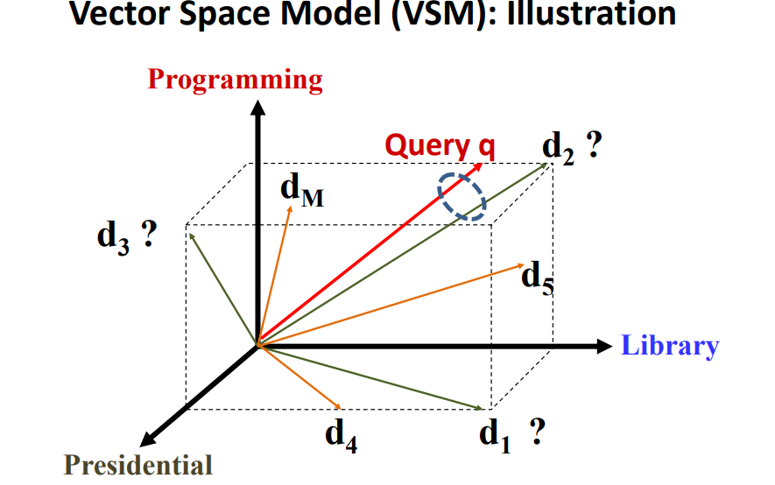
Vector Model
Documents/Query/words are all represented as vectors. Where Words are represented as dimensions..
If the Query vector and Document vector are closer then it means that the document matched the query

Slide 12

Well known ranking algorithms based on Vector Space Model
Pivoted Length Normalization ranking function
Here c(w,q) is the count of words in the query
ln is the natural log to non-lineary calculate the term frequency c(w,d).
M is the numer of Documents in the corpus
df(w) is the number of documents have the term.
|d| is the length of the document
Avd1 is the average length of all the documents
b is a number between [0,1]. The higher the b is the longer document is penalized more

Slide 13

Okapi/BM25
Okapi/BM25 ranking function is similar to Pivoted length
Here c(w,q) is the count of words in the query
Instead of Log we are using a function to non-linearly calculate term frequency ((k+1) c (w,d)/c(w,d)+k)
M is the numer of Documents in the corpus
df(w) is the number of documents have the term.
|d| is the length of the document
Avd1 is the average length of all the documents
b is a number between [0,1]. The higher the b is the longer document is penalized more
Higher the K the term frequency becomes linear to the term occurrence. This is between [0 and infinity]

Slide 14
Popular ranking evaluation in Web search -NDCG
NDCG- Normalized Discounted Cumulative Gain
Assume that when we search we got following documents in this order of relevance – 3 being most relevant – 0 being least
DCG=3+2/log2+3/log3+4/log1+5/log2
Ideal DCG is getting the documents in the best order
Ideal DCG=3+3/log2+2/log3+12log4+5/log1
NCDG=DCG/Ideal DCG
We are normalizing as to we could compare the ranking functions with various difference searching parameters.
Document | Relevance
D1 | 3
D2 | 2
D3 | 3
D4 | 1
D5 | 2

Slide 15
NDCG- Normalized Discounted Cumulative Gain
Applicable to multi-level judgements in scale of [1,r], r is relevance level of document r>2 the higher the r the more relevant the document is.
Main idea of nDCG@k is to evaluate the algorithm for a retrieval of top k documents. Here the k could be 5 or 10. As we the users are only interested in top searched documents

Slide 16
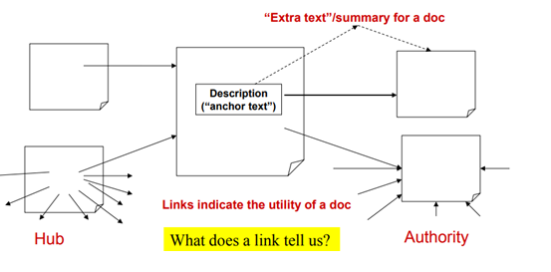
Page Rank
Exploiting Inter-Document links
Anchor Text – The Text the describes the link.
Hub- The page which has many links to multiple other pages
Authority – the Page which has many in-links

Slide 17

High Rank = High Page Popularity
Links are like citations in literature
A page that is cited often can be expected to be useful
PageRank is essentially “Citation Counting”
Page Rank Algorithm creates an Adjacency matrix based on the links
The probability of going from page di to dj is calculated based on this matrix

Slide 18
Combination of Content + Page Ranking
When we search of a query the document which has high relevance + the document which has high authority needs to be presented.
Here a combination of both the ranking function + the page ranking function are used

Slide 19
Natural Language Processing is Vast
Word division could vary- Example Chinese
Algorithm applicable for one topic could not be applicable to other topics
User Feed is necessary to improve the ranking either by clicks (implicit) or by explicit feed back(Which is very tuff)
Zipfs Law- Ranking of a word * Frequency of a word = Constant ( Low rank words like of, the, an are very frequent + High rank words which are useful for us are not frequent)

Slide 20
Conclusion
NLP is diverse
The research in NLP is able to address only the shallow problems called Shallow NLP
However deeper NLP requires Machine Learning + User Experiences + A lot of feedback data so as to train the computers to tackle the problems.
NLP is iterative process

